Slide 1
UK Autos Outlook
Anna-Marie Baisden, BMI Research

Slide 2
Europe autos outlook
Europe Passenger Car Sales By Market % chg y-o-y
Record low interest rates, rising real wages and low household debt compared to developed peers give Emerging Markets room to grow
Long-term consumer confidence and low borrowing costs are positive for Central and Eastern Europe sales for next five years
Western Europe losing Spain and UK as long-term outperformers – Spain cutting subsidies, UK’s short-term Brexit impact

Slide 3
UK autos outlook
UK Passenger Car Sales, units
UK has been a European outperformer for car sale growth in previous years
Total vehicle sales in 2016 will decline 1.5% , followed by a 0.6 drop in 2017
Biggest decline in the passenger car segment as consumer confidence is weakened and prices increase
Car sales will average growth of just 1.2% over 2018-2020, staying around 2.5-2.6mn units
35%

Slide 4

Brexit brings uncertainty

Slide 5
What is Brexit?
Vote again: a series of concessions from the EU could result in a second vote on new conditions
UK stays with greater concessions: the EU might offer concessions to prevent Brexit
European Economic Area (‘Norway Model’): keep the Single Market but no input on decisions
‘Associate Membership’: similar to above but with some free movement exemption and more influence
‘Swiss Model’: European Free Trade Area plus bilateral agreements with the EU
Turkish-style customs union: reduced restrictions on trade of certain goods with the EU
WTO: no agreement is reached and the UK falls back on ‘most-favoured nation’ status from WTO

Slide 6
UK sales impact
UK Passenger Car Imports By Origin in 2015, % of Total Import Value
Import reliance will be negative, sustained currency weakness will see prices rise
Potential for M&A in the retail segment, smaller dealers likely to struggle

Slide 7
UK sales impact
  Financed sales grew 10% in 2015, compared with 6.3% for total passenger car sales
  Sales to consumers on credit accounted for 81.4% of all sales to consumers, up from 75.9% in 2014
  Credit reliance erodes consumer confidence, especially when there is economic uncertainty
  Weak currency will add to total cost of buying a car
UK Passenger Car Sales By Finance Type, units and % of Total Sales

Slide 8
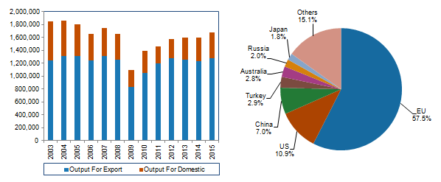
UK manufacturing impact
Vehicle Production (LHS), Export Markets By % Of Total (RHS)
Investment projects in the UK could be stalled, diverted to EU or scrapped altogether, due to uncertainty over a trade deal
Labour shortages could worsen and costs rise, due to reliance on European skilled labour
R&D funding could be cut, which would also impact European companies using UK R&D bases

Slide 9
Regulatory impact
UK industry could find itself outside of regulation negotiations, having less influence in the setting of standards
Comes at a time when emission standards and testing are in focus, future standards and decisions over testing procedures to come
Would also leave the UK outside of setting regulation for some of the biggest areas of development in the industry for decades:
Connected Cars
Autonomous Cars
Ride-sharing and Car-sharing
European producers would be in a much stronger bargaining position

Slide 10
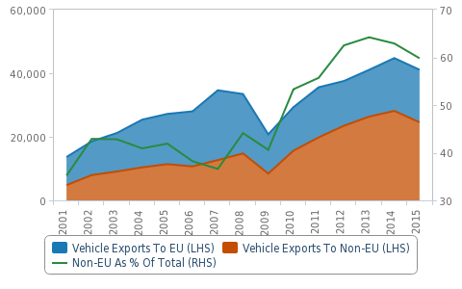
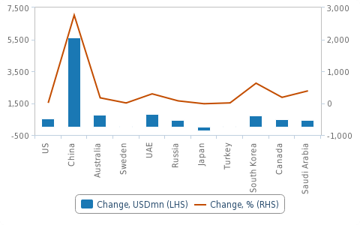
Brexit opportunities
  Short-term sterling depreciation will give exports a competitive edge
  Increase in repatriated earnings for premium brands that have struggled to make a profit
  Exports to non-EU destinations have already been increasing and offer an opportunity for growth
  Advantages more on the premium side as volume brands often rely on EU for components
UK Motor Vehicle Exports (USDmn)
Change In Autos Exports To Non-EU Destinations
Source: TradeMap
Source: ITC

Slide 11
Fleet still growing...
  Fleet growth will remain positive but not at the highs seen in 2011 to 2015
  Commercial vehicle fleet growth will be higher than passenger cars
  Car fleet hit 30mn units for the first time in 2015
  Used car market hitting record levels with PCPs playing a role
Vehicle Fleet By Segment, units (LHS) And Fleet Growth, % chg y-o-y (RHS)
Source: Dept for Transport, BMI forecasts

Slide 12
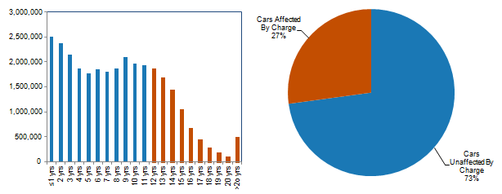
Regulatory risk to fleet growth
UK Passenger Car Fleet By Age, mn units (LHS) , Cars Impacted % Of Total (RHS)
Source: FLA, SMMT, BMI estimates
  Moves to cut emissions in London by charging pre-2005 light commercial vehicles to enter the city, plus proposals for a diesel scrappage scheme threaten fleet growth
  At 8% of the total UK vehicle fleet, changes in London would have a bigger impact than other European capitals –
  eg Paris at 2% of national total
  If regulations were adopted nationally, it would become a much bigger threat to fleet growth

Slide 13
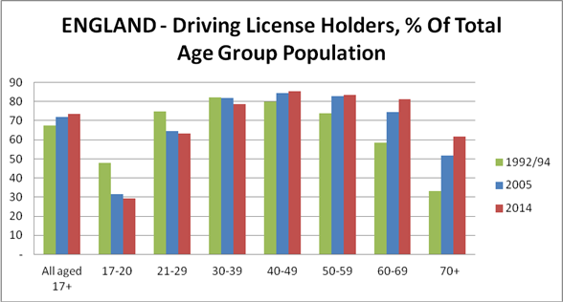
Future risks to new sales
Total number of licence holders still growing but increase is decelerating
Youngest age groups in steady decline
Growing cost of ownership and boom in alternatives changing consumer sentiment
Source: Dept for Transport

Slide 14
Market opportunities - Connectivity
Modern Transport bill aims to make the country a leader in automotive tech – connected, autonomous, electric
Growth in combined car ownership and 3G/4G subscribers bodes well for uptake
BT/EE’s scale of LTE coverage can be leveraged for connectivity
A Mature Market In Both Industries
Passenger Cars And 3/4G Penetration, 2014-2020
Source: BMI

Slide 15
Market opportunities – Alternative Fuels
Strongest growing fuel category, but from a much lower base
Petrol-electric hybrids account for biggest volumes, but highest growth comes from plug-in ‘other electric’
Diesel-electric is the only AFV segment to decline in 9M16 – 62.3%
Traditional diesel sales still growing
UK Alternative Fuel Vehicle Sales, units
24.3%
Source: SMMT

Slide 16
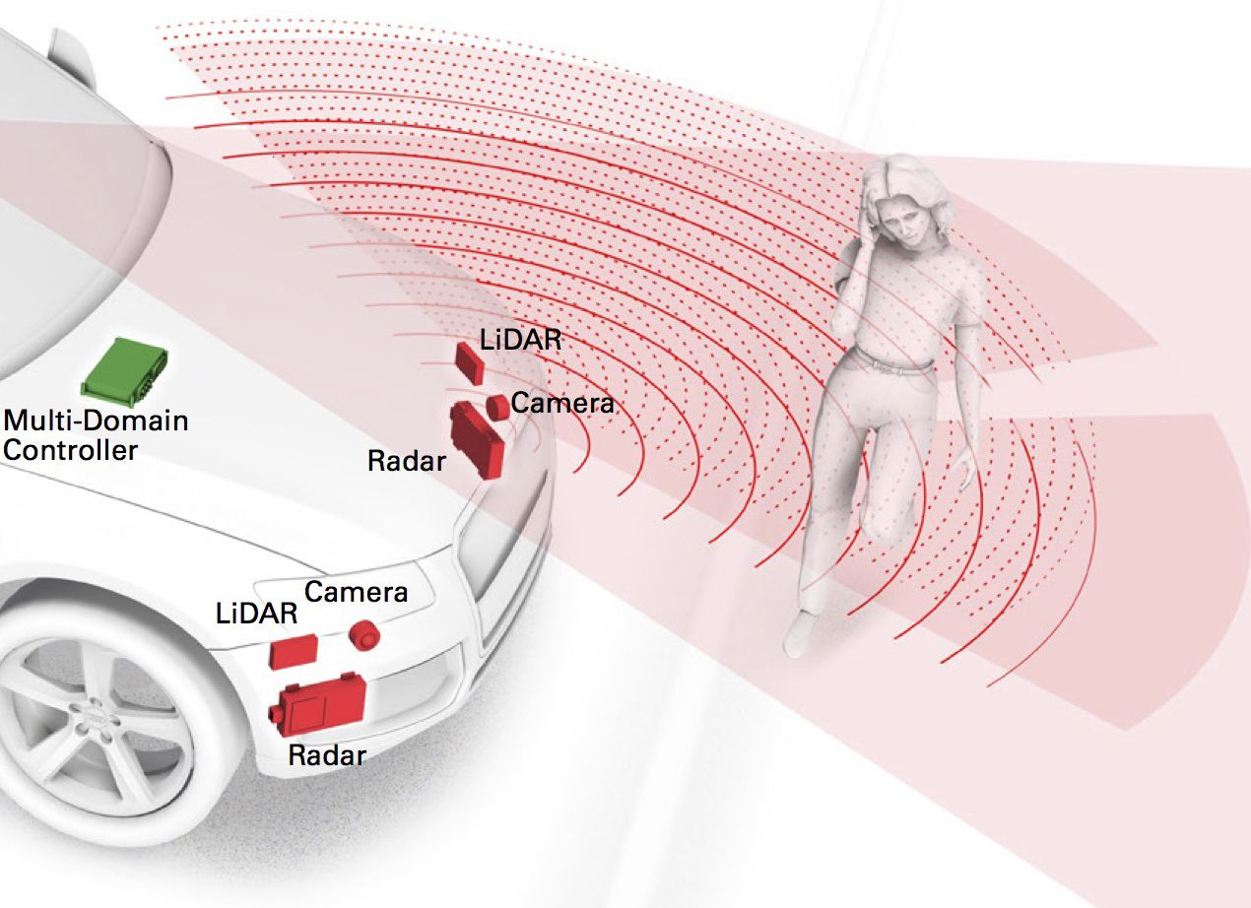
Market opportunities - Autonomy
Delphi Automotive joining with Mobileye for autonomous tech takes advantage of industry trends
Combined expertise create ‘one-stop shop’ for autonomy
Well placed to service OEMs without that don’t have their own autonomy programmes
Source: Mobileye

Slide 17
Thank you

