Slide 1

Household incomes, Brexit and the Autumn Statement: Winter is Coming
Paul Johnson

Slide 2
Pre-referendum forecast: GDP per capita only just back to pre-crisis levels
Source: Office for Budget Responsibility (2016)

Slide 3
Median income since 2003-04
1%
Source: Figure 2.3 of Living Standards, Poverty and Inequality: 2016

Slide 4
Median income since 2003-04
2%
Source: Figure 2.3 of Living Standards, Poverty and Inequality: 2016

Slide 5
Median income by age
All
Source: Figure 2.6 of Living Standards, Poverty and Inequality: 2016

Slide 6
Median income by age
All
Source: Figure 2.6 of Living Standards, Poverty and Inequality: 2016

Slide 7
Median income by age
All
22-30
Source: Figure 2.6 of Living Standards, Poverty and Inequality: 2016

Slide 8
Median income by age
All
31-59
22-30
Source: Figure 2.6 of Living Standards, Poverty and Inequality: 2016

Slide 9
Median income by age
+11%
60+
All
31-59
22-30
Source: Figure 2.6 of Living Standards, Poverty and Inequality: 2016

Slide 10
So we go into next few years
After several years of very poor growth
With interest rates as low as they can go
  After a record period at record low levels
With a dreadful productivity record
With incomes doing very badly by historic standards
And as a result a budget deficit which remains substantial

Slide 11
Pre-referendum forecast: deficit reduced from peak, but some way off being eliminated
Source: Office for Budget Responsibility (2016)

Slide 12
A lot more “austerity” was planned
A budget tightening of 3% of national income implied a lot more “austerity”
  Further cuts in working age benefits
  Very slow growth in NHS spending
  Real cuts in “unprotected” areas
And debt would still be around 80% of national income

Slide 13
Though that’s not so high by historical standards
Source: Office for Budget Responsibility (2016)

Slide 14
Brexit will make things worse
Short run effect has been on the exchange rate

Slide 15
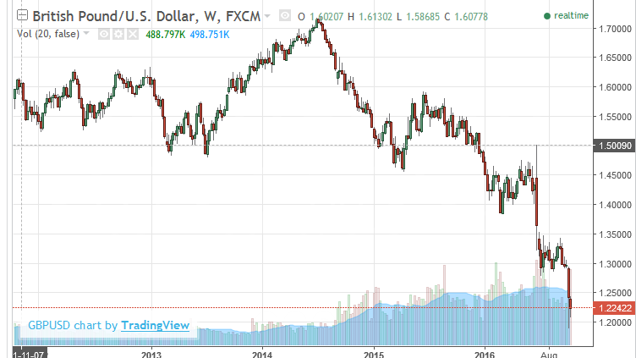
The collapse of the pound

Slide 16
Brexit will make things worse
Short run effect has been on the exchange rate
Which will result in higher prices
The next big concern is about investment
No data yet but increased uncertainty likely to reduce investment, especially FDI
Even so Bank of England thinks national income will be 2.5% lower by 2019 than it would have been

Slide 17
Bank of England growth forecasts downgraded
2½% downgrade
Sources: Bank of England; Office for Budget Responsibility.

Slide 18
Brexit will make things worse
Short run effect has been on the exchange rate
  Which will result in higher prices
The next big concern is about investment
  No data yet but increased uncertainty likely to reduce investment, especially FDI
Bank of England thinks national income will be 2.5% lower by 2019 than it would have been
Though real effects will be in the long run

Slide 19
What drives long run economic impacts?
It looks likely we will leave both the single market and the customs union
  Raising both tariffs and “non tariff barriers
So trade costs will rise, impact depending on
  Nature of trade deal / membership of single market
  Importance of “dynamic” effects especially of reduced FDI reducing investment and productivity
Nearly half our trade is with the EU
  No other trade agreement could make up for barriers within EU
Wide variety of long run estimates
  Ranging from small GDP losses to losses of 8% or more
  (Best estimates suggest membership of EU had big positive impact on GDP)

Slide 20
This will damage public finances
Elimination of the UK’s net financial contribution to the EU would strengthen the public finances by about £8 billion (≈£150m per week)
But relatively small change to GDP would dominate this
  loss of 0.6% GDP wipes out £8 billion gain to public finances from ending budget contributions
Unfortunately nearly all forecasters suggest bigger GDP losses than that

Slide 21
So where now for fiscal policy?
Surplus target for 2019-20 seems to have been abandoned
  Despite being legislated only last year
But that need not mean the “end of austerity”
My Hammond might in fact decide to extend austerity
  at its current pace that might get us to surplus a year or two later
Or he might decide on something else entirely
  allowing borrowing to finance investment spending
  Focussing on a debt to GDP ratio
  Revert to Osborne’s initial rule of targeting forecast surplus 5 years out
Uncertainty over economic developments is pervasive

Slide 22
Short run stimulus is possible
Very difficult judgment given uncertainty
  would add to borrowing, but borrowing cheap
Only a response to short run economic cost
  If potential output falls, in the end fiscal policy will need to be tightened
Any stimulus package should be Targeted, Timely and Temporary
Could push back fiscal tightening and/or announce new measures:
  one-off boost to public sector investment spending
  temporary cut to the main rate of VAT
  a time-limited tax break to encourage companies to invest
  a stamp duty holiday to stimulate housing transactions
Versions of all these measures were implemented by Alistair Darling

Slide 23
Conclusions
Incomes for all have been squeezed
Young have done especially badly
  And many middle income families struggling to get on “housing ladder”
Substantial further fiscal tightening planned as of March
If economy does less well than expected post June 23 that will no longer get us to surplus by 2019-20
In the Autumn Statement the new Chancellor will need to decide
  what level of borrowing to aim for in the longer-term, and how quickly to try to get there: further austerity beyond 2019–20 likely
  whether to announce temporary fiscal easing to boost UK economy
In the context of, perhaps unprecedented, levels of uncertainty over the path of the economy

Slide 24

Thank you

